Slide 1


ABSTRACT ESSENTIALS
Writing Support Desk
writingsupport@uwindsor.ca

Slide 2


WHAT IS AN ABSTRACT?

Slide 3

DEFINITION
Adjective: an idea that is not concrete
Verb: to extract
Noun: a summary
6

Slide 4
WHY WRITE ABSTRACTS?

Slide 5

PEOPLE ARE BUSY!
Researchers, academics, and conference organizers are busy
Reading a whole paper is a time investment

Slide 6

ABSTRACTS SAVE TIME
Abstracts help academics approve a submission without reading the entire thing
They can also help researchers decide if a paper is relevant to read later

Slide 7
WHAT MAKES AN ABSTRACT?

Slide 8
PARTS OF AN ABSTRACT
Research Question
Background & Importance
Methodology
Findings
Keywords

Slide 9

RESEARCH QUESTION/PROBLEM
Get straight to the point!
First sentence should state research question/problem
Does not have the be in the form of a question
Key is to be immediately clear about direction of your research
6

Slide 10

EXAMPLE RESEARCH QUESTION/PROBLEM
Although research has been done showing that dysphoria correlates with an increased amount of mood congruent false memories in both dysphoric participants and negative mood induced participants, no research prior to this study has examined how inducing a negative mood in dysphoric participants affects mood congruent false memories.
6

Slide 11

BACKGROUND
Where does current research stand?
What gaps exist in the current research?
What foundation are you building on?
What are the benefits of filling the gaps in research?

Slide 12

IMPORTANCE
Explain how you will fill those gaps
What is it that you seek to accomplish?
Background and Importance often overlap significantly (and sometimes overlap with Research Question)
6

Slide 13

EXAMPLE BACKGROUND
Although research has been done showing that dysphoria correlates with an increased amount of mood congruent false memories in both dysphoric participants and negative mood induced participants, no research prior to this study has examined how inducing a negative mood in dysphoric participants affects mood congruent false memories.
6

Slide 14

METHODOLOGY
Not just what you will prove but how you will prove it
Can include methodological and/or theoretical approaches
Quantitative? Qualitative?
Case study? Correlation?
6

Slide 15

METHODOLOGY
Why this methodology? What are its benefits?
What variables and why?
Usually the longest part of your abstract
Value of your conclusions hinges on credible methodology
6

Slide 16
WHAT IF I DON’T HAVE A METHOD?

Slide 17

METHODOLOGY
You don’t have to conduct a study with participants to have a methodology!
Wrote a literature review? That’s a method!
May also discuss a theoretical approach, theorists, and benefits of these choices
6

Slide 18

THEORY
A lens to examine an idea
Social work: resilience or strength-based approach
Nursing: descriptive, explanatory, predictive
Education: special education, multiliteracies
Literature: reader-response, post-colonial
6

Slide 19

LITERATURE REVIEWS
An abstract doesn’t have to be for a work of original research
Collecting the work of other scholars is still a method, even if you do not necessarily draw a new conclusion
Follow the same steps, noting any conclusions you may have drawn
6

Slide 20

BUT I’M NOT DONE!
Research in progress? Don’t worry!
UWillDiscover accepts abstracts for work in progress
Preliminary results? Be clear on scope and be frank
Projected results? Again, be clear these are not final
6

Slide 21

ARTIST’S STATEMENTS
Similar to abstracts in function and structure
Tend to be more personal
Main theme or idea of work?
Relate to previous practice?
Why make this art?
Influences?
Expected/intended reactions?
Technique, theory, or method (and why!)

Slide 22

ARTIST’S STATEMENTS
NOT your personal biography as an artist
May include autobiographical elements
An artist may have different statements for different works or collections of works within their practice
May use first-person pronoun ‘I.’

Slide 23

EXAMPLE METHOD
One hundred undergraduate participants viewed lists of depression-relevant, neutral and positive words that they were asked to recognize later among lure words. Participants were grouped as dysphoric, mid-dysphoric, or non-dysphoric as determined by BDI-II scores. This study hypothesized that dysphoric participants induced into a negative mood would have a greater number of mood congruent false memories than all of the other groups. A 2 x2 x3 x 3 – way mixed-model analysis of variance (ANOVA) with Mood Induction (positive, negative), Gender (male, female), and Group (dysphoric, mid-dysphoric, non-dysphoric control participants) as between-subject variables and Word Type (depression-relevant, neutral, positive) as a within-subject variable and correlation analyses were used to examine the depression relevant false memory results.
6

Slide 24

FINDINGS
Spoil the ending!
What were the results?
What is the importance of these results?
Most important part of your abstract
Reinforce implications of your results / how vital they are

Slide 25

EXAMPLE FINDINGS
Correlation analyses revealed that dysphoria is related to an increased amount of mood congruent false memories (r = .22; p< .04). The results of this study add to previous research in the field of depression and memory on a small scale. Further research in the area is needed for a more complete understanding of how memory functions in dysphoric individuals, and may be used to augment or create treatment techniques.

Slide 26

KEYWORDS
Help highlight relevance of your work and make it easier to find/categorize
Think of them like hashtags on a tweet or Instagram post
4-6 keywords is usually a good range
6

Slide 27
HIGHLIGHTER
ACTIVITY

Slide 28
BONUS TIPS

Slide 29

KEEP IT SHORT!
Most abstracts are under 250 words
Combine sections to save space
Check the requirements of your particular conference / journal / assignment
6

Slide 30

CHECK RESTRICTIONS
Length of paper?
Citation style? Chicago? APA? MLA? IEEE?
Topic and keywords?
Any other restrictions in the call for papers or assignment instructions
Make a checklist!
6

Slide 31

THINK ABOUT AUDIENCE
Who is reading the paper/watching the presentation?
Multidisciplinary audience or someone familiar with your field?
Avoid jargon when possible depending on audience
6

Slide 32
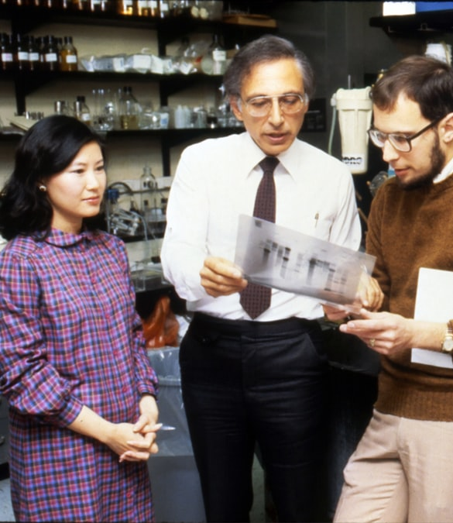
CONSIDER IMPARTIALITY
Don’t overstate the importance of your work
If there are limitations, be frank about them
Discuss work in the context of an ongoing discourse and continuing research
6

Slide 33

AVOID CITING & REFERENCING
Save citing and referencing for body of your paper
Abstracts should be fairly general
Avoid specific stats & graphs
6

Slide 34

AVOID INITIALIZATIONS & LESSER-KNOWN NAMES
Generally stay away from abbreviations unless for very well-known organizations (NASA, FBI, etc.)
Only mention recognizable people, not lesser-known researchers (discipline specific)
6

Slide 35

FINAL THOUGHTS
Following these steps and tips will help you clearly communicate the main points of your work
When researching, be on the lookout for what makes a strong abstract!
6

Slide 36
QUESTIONS?
Remember, this slideshow and many others are available to download via the Writing Support Brightspace page.
Students can self-enroll as 'learners' either by selecting 'Discover' from the Brightspace landing page and clicking 'Enroll' on the Writing Support organization.

Slide 37
Abstract examples are from Michigan State University’s Undergraduate Research page:
https://urca.msu.edu/abstract-samples
Images are Creative Commons via Unsplash

